Slide 1
Chapter 5
DEFINING

Slide 2
We’ve looked at the following rhetorical functions in English language
Classifying
Comaring
Cause and Effect
Hypothesizing

Slide 3
Defining
to explain something;
to say the meaning of something;

Slide 4
Defining
to explain something;
to say the meaning of something;
Scientists must make sure they are understood by other researchers. Misunderstandings occur when there are different concepts of what is being discussed.

Slide 5
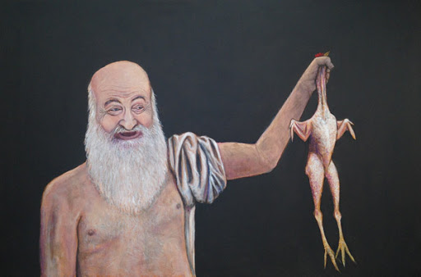
Giving a precise definitions of substances, concepts, processes and ideas.
The Greek philosopher Plato once defined
man as a two-legged (biped) creature that has
no feathers. His critic Diogenes left the room
and brought back a plucked chicken, declaring,
“Here is Plato’s man!”

Slide 6
Definition answers the question
WHAT IS IT?

Slide 7
Good definition should include

Slide 8
Good definition should include the general classification of a term

Slide 9
Good definition should include the general classification of a term
+

Slide 10
Good definition should include the general classification of a term
+
the specific characteristics that differentiate the term from other members of its class.

Slide 11
Defining
Example
Chemical energy is potential energy

Slide 12
Defining
Example
Chemical energy is potential energy ( general classification)

Slide 13
Defining
Example
Chemical energy is potential energy ( general classification) that is stored in gasoline, food, and oil.

Slide 14
Defining
Example
Chemical energy is potential energy ( general classification) that is stored in gasoline, food, and oil. (specific characteristic)

Slide 15
Defining
Example
Chemical energy is potential energy ( general classification) that is stored in gasoline, food, and oil. (specific characteristic)
Sometimes, the characteristics appear as a relative clause beginning with which, that, who, or where.

Slide 16
Try to come up with examples for the following words:
Mechanical energy-that is related to the movement of objects - energy
COVID-19-caused by a newly discovered coronavirus - is an infectious disease
a degree - master’s degree - that is given to a student by a university usually after one or two years of additional study following a BD.

Slide 17
Try to come up with examples for the following words:
Mechanical energy-that is related to the movement of objects - energy
COVID-19-caused by a newly discovered coronavirus - is an infectious disease
is a degree - master’s degree - that is given to a student by a university usually after one or two years of additional study following a BD.
Mechanical energy is energy related to the movement of objects.
COVID-19 is an infectious disease caused by a newly discovered coronavirus.
Master’s degree is a degree that is given to a student by a university usually after one or two years of additional study following a BD.

Slide 18
Short Reading: THE MANY FORMS OF ENERGY
Read the following passage to find definitions for as many types of energy as you can.

Slide 19
Short Reading: THE MANY FORMS OF ENERGY
Read the following passage to find definitions for as many types of energy as you can.
Energy is the ability to do work. When a hammer strikes a nail, it exerts a force on the nail that causes it to move. The movement of the hammer has the ability to do work and therefore has a form of energy that we call kinetic energy. Kinetic energy is the energy of motion.

Slide 20
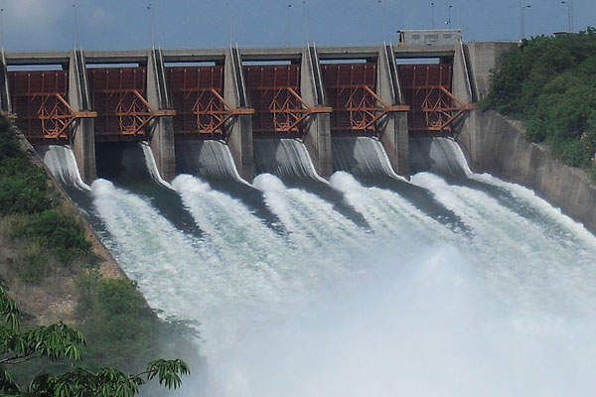
Short Reading: THE MANY FORMS OF ENERGY
Read the following passage to find definitions for as many types of energy as you can.
An object may have energy not only because of its motion but also because of its position or shape. For example, when a watch spring is wound, it is storing energy. When this energy is released, it will do the work of moving the hand of the watch. This form of energy is called potential energy. Potential energy is stored energy. Water in a dam is another example of potential energy.

Slide 21
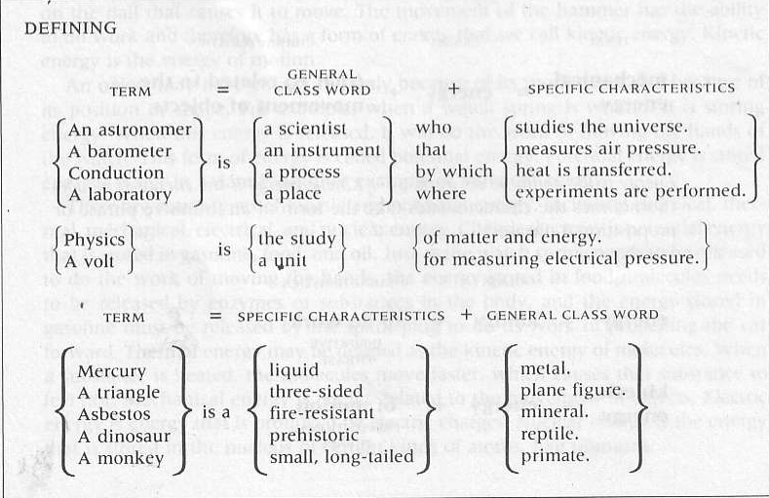
Sentence Patterns

Slide 22
When defining remember the following
Definitions require the present simple tense and the verb to be

Slide 23
When defining remember the following
Definitions require the present simple tense and the verb to be
For example:
A laboratory is a place where scientists perform experiments.

Slide 24
Analyzing Definitions
In each of the following definitions, underline the general class once, and the specific characteristic(s) twice.
Protozoa are one-celled organisms.
The cerebrum is the part of the brain that is the center of reasoning.
Fog is a cloud that forms on the ground.
Ecology is the study of the environment.
Helium is an inert gas that is light and nonflammable.

Slide 25
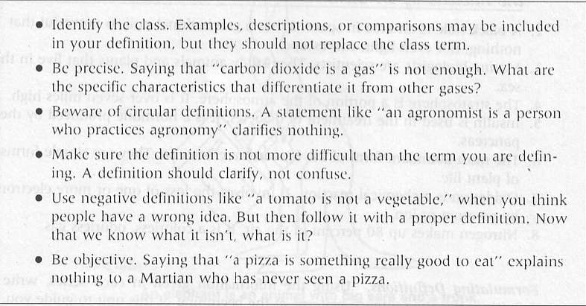
Guidlines for writing good definitions:

Slide 26
What’s wrong with the following definition. Discuss how you would improve it.
A scientific theory is a theory like Darwin’s theory.
An apple is round, red and about the size of a fist.
Calculus is a tough subject.
An ear is an auditory appendage of Homo sapiens and other species.
A unicorn is not a real animal.
Tornadoes are very dangerous.
Radium is an element.
A compass looks like a clock.
A supernova is a big nova.
An amphibian is like a frog or a turtle.

Slide 27
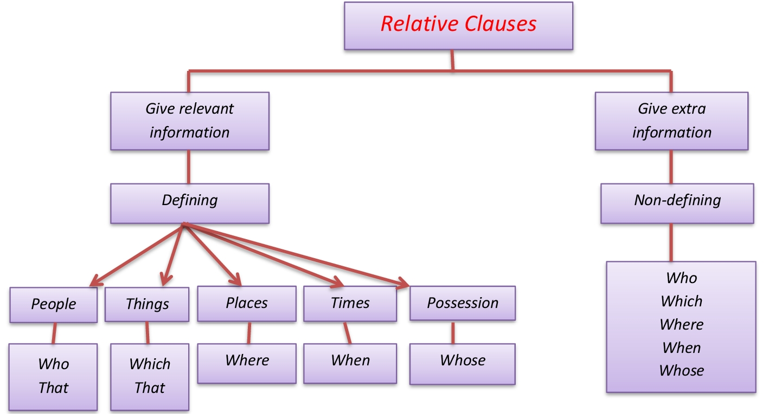
Relative Clauses

Slide 28
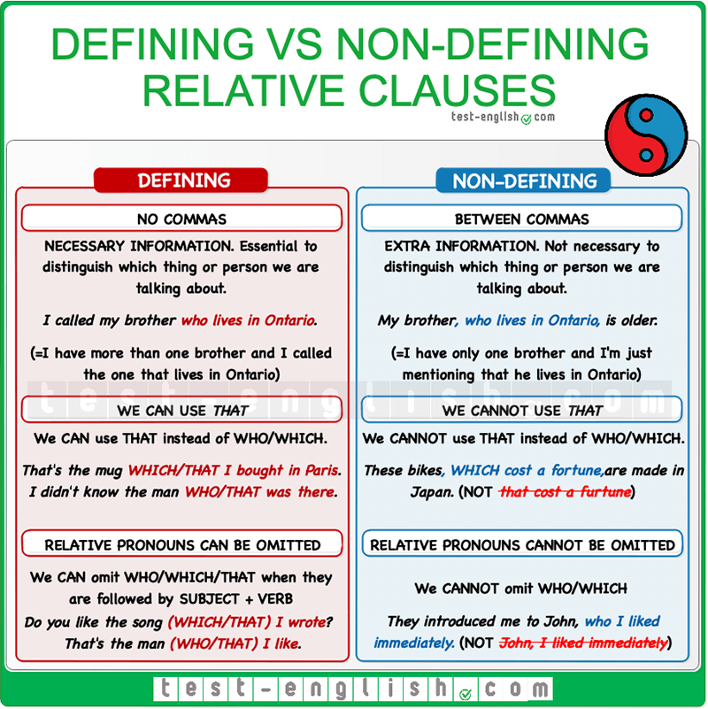

Slide 29
Formulating Definitions
Using the information given in each series, write a definition. Use the sentence patterns at the beginning of this unit to guide you.
an amoeba/one-celled animal/constantly changes its shape
an antibiotic/drug/cures bacterial diseases
lung/organ/breathing
photosynthesis/process/plants manufacture food
catalyst/substance/speeds up but is not changed by a chemical reaction
cyclotron/apparatus/bombards the nuclei of atoms

Slide 30
Creating Definitions
A good way to see if a definition is complete is to reverse it. For example, if we reverse mitochondria is an organelle, we get an organelle is mitochondria.
Mitochondria is an organelle which stores energy.
An organelle which stores energy is mitochondria.

Slide 31
an x-ray
a butterfly
a virus
an aquarium
a smartphone

Slide 32
Vocabulary: prefixes
ecto- or exo-
endo-
micro-
macro-
outside
inside
small
large

Slide 33
__1. ectoplasm
__2. endoplasm
__3. microbe
__4. microscope
__5. macronucleus

Slide 34
Vocabulary
Frayed electrical wires are potential fire hazards.
The velocity of the wind increased during the storm.
Despite the head-on collision, the engine remained intact.
The conservation of natural resources, such as rivers and forests, is an important issue of our time.
When the temperature dropped, vapor accumulated on the inside of the window.
Pasteur’s germ theory proved to be valid and was a major breakthrough in the history of medicine.
When the bottle was uncapped, all the pressure inside was released.
Energy is released by the fission of atomic nuclei
The cold on top of the mountain got more intense later in the evening.
An alloy is a fusion of two or more metals that makes a stronger metal.

Slide 35
Homework
New vocabulary (find collocations)
Read the text; answer the questions
Watch the energy video
Complete the grammar exercise

Slide 36
THANK YOU
Notes:
Thank you

